Slide 1


Data Analysis Bootcamps-DAB16
Python Project: NORS Data Set
NullBrains Group
Batool
Rana
Sayed Ahmed

Slide 2

Introduction
The Centers for Disease Control and Prevention (CDC) National Outbreak Reporting System (NORS) dataset provides detailed records of outbreaks from 1971 to 2023, including information on the location, etiology, mode of transmission, and number of illnesses, hospitalizations, and deaths.

Slide 3
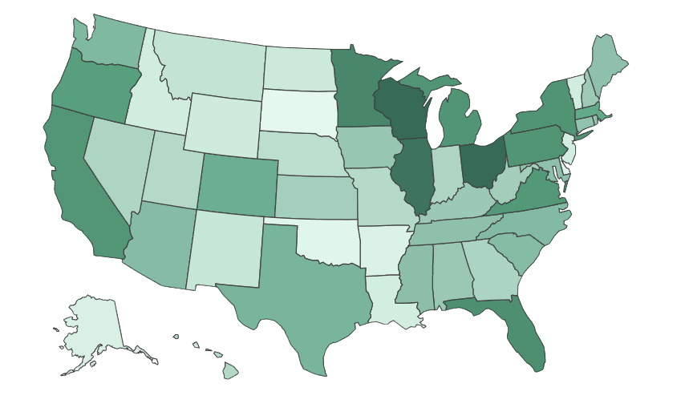


Outbreaks In The United State
1971 - 2023
Around 64,000 outbreaks
38%
FOODBORNE
49%
PERSON TO PERSON

Slide 4



Approach
How have outbreak patterns changed over the years?
Which states account for the highest percentage of reported outbreaks?
Which pathogens are associated with the greatest number of outbreaks, illnesses, and deaths?

Slide 5
Outbreaks Trends

Slide 6
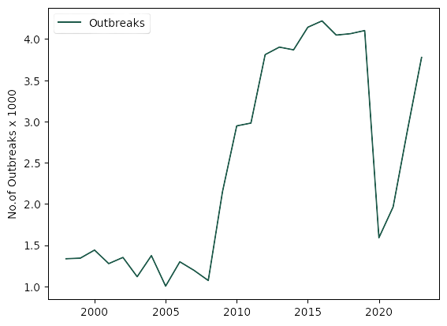
Number of outbreaks per year
96.33%
Outbreaks in
1998 - 2023

Slide 7
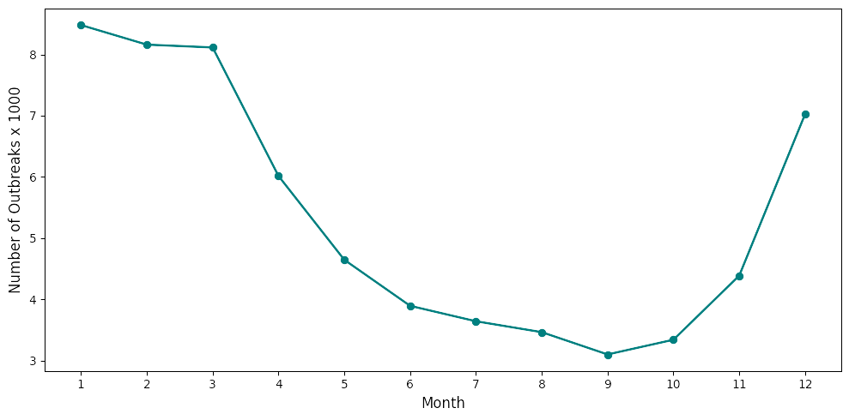
seasonal trend

Slide 8
Modes & Effects

Slide 9
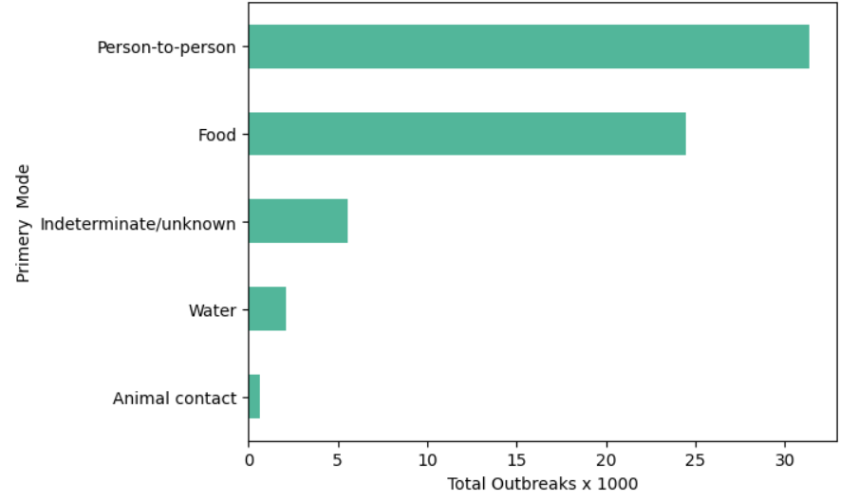
Modes of Transmission
Pathogens | Outbreaks | Primary Mode
Salmonella enterica | 3,100 | Food
Norovirus Genogroup II | 6,300 | Person To Person
Legionella pneumophila | 711 | Water

Slide 10
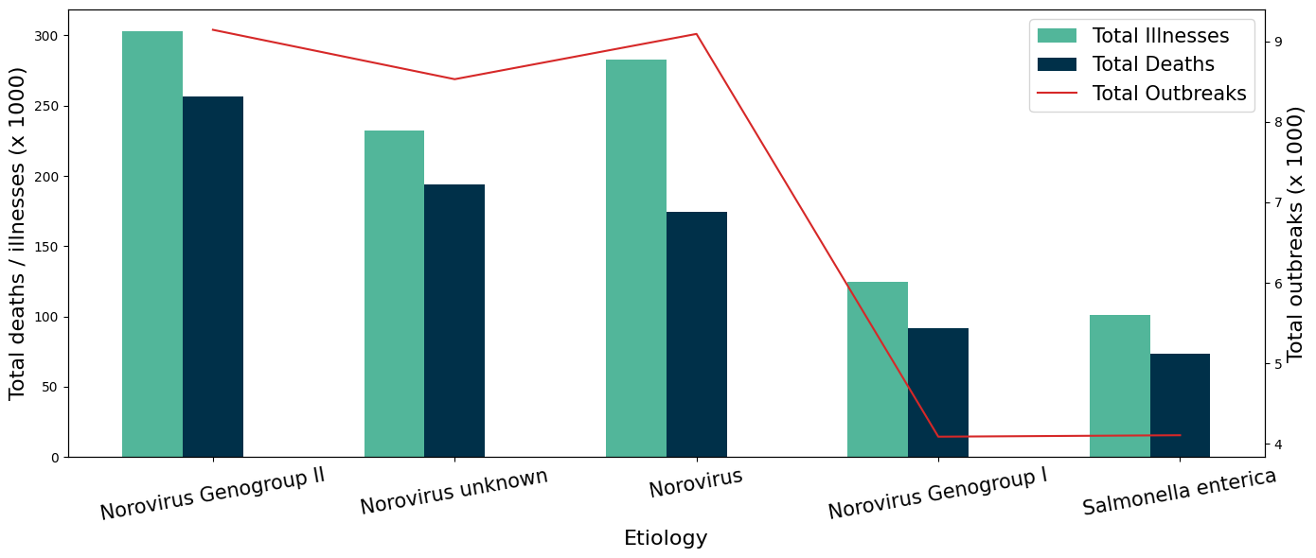
Effect of Pathogens
Norovirus Genogroup II | Norovirus Genogroup II
deaths | 260,000
illnesses | 303,000
outbreaks | 9,100

Slide 11

Norovirus Genogroup II
Effect
Nausea and vomiting
Watery diarrhea
Low-grade fever
Recovery
recover in 1–3 days
Seasonal Peaks
Winter

Slide 12
Outbreaks Settings

Slide 13
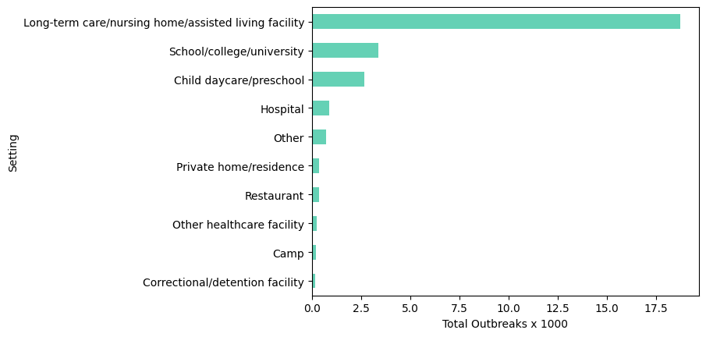
Person to Person Transmission

Slide 14
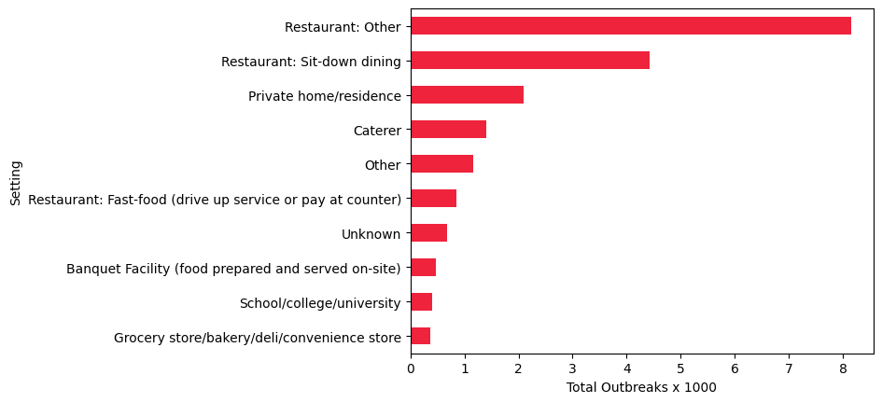
Food Transmission

Slide 15
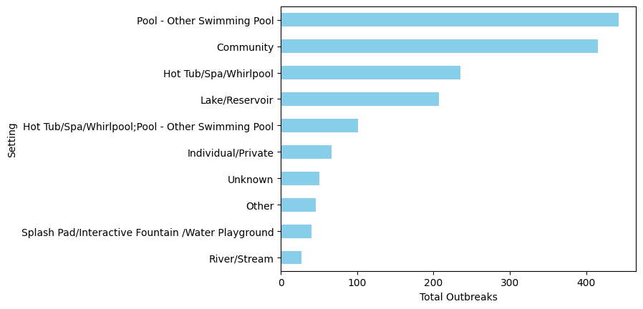
Water Transmission

Slide 16
Geographic Distribution of Outbreaks

Slide 17
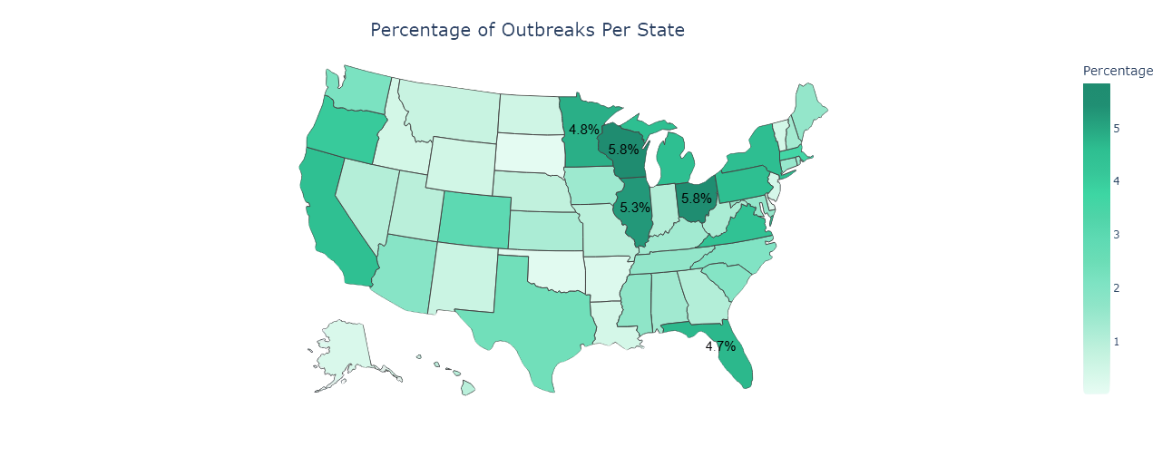
Percentages of Outbreaks Per State
State | Percentage
Wisconsin | 5.83%
Ohio | 5.77%
Illinois | 5.25%
Minnesota | 4.85%
Florida | 4.71%

Slide 18
Limitations
Underreporting
Data limitation
Geographic scope

Slide 19
Conclusion
49%
person to person transmitted
Norovirus Genogroup II
most sever pathogen
Nursing Home, Restaurant & Pools
most contaminated places
5.83%
Outbreaks in Wisconsin
Winter
Seasonal Peak

Slide 20
Recommendation
Person to Person
Food
Water
Vaccination
Quarantine
PPEs
Consumer’s precautions
Hygiene practices
Proper water treatment
Wastewater management

Slide 21

Data Analysis Bootcamps-DAB16
Thank you very much!

